Slide 1
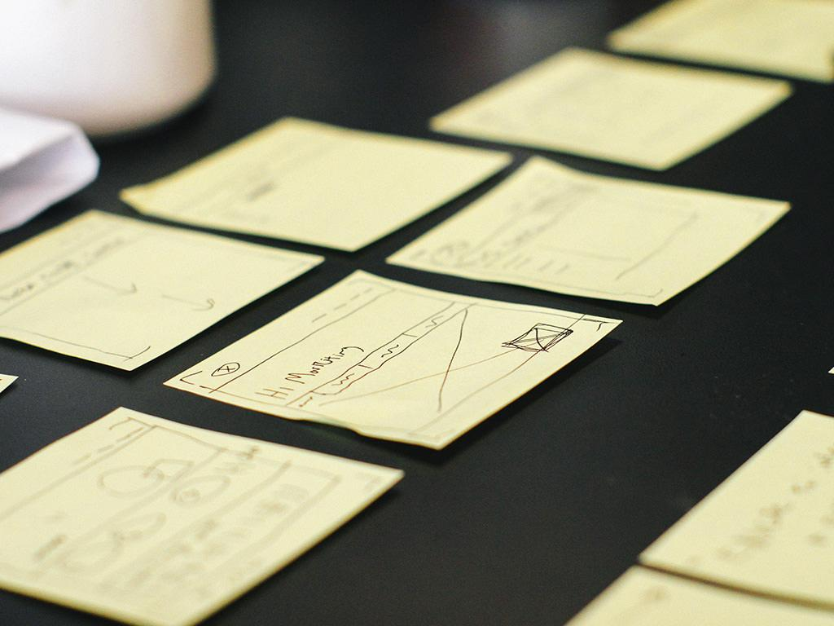

Some and Any

Slide 2
SOME
We use SOME in affirmative sentences and when we want to offer or ask for something.
There are some new people in my English class.
I bought some new shoes.
There is some milk in the fridge.
I took some money out of the bank.

Slide 3
Using SOME to offer something
Would you like some wine?
Do you want some soup?
I’ve got a lot of apples. Do you want some?
You look thirsty. Have some water.
Have some cake… it’s delicious!
If you’re hungry, eat some chips.

Slide 4
Using some to SOME for something
Can I borrow some money?
Could you give me some books to read on vacation?
Can I have some more coffee?
Could you give me some help with this?
Would you please give me some apples?

Slide 5
ANY
We use ANY with negative sentences or with questions that are neither offers nor orders.
There isn’t any beer in the fridge.
There aren’t any good films on TV.
Are there any good restaurants near here?
Do you have any children?
I’d like to learn another language, but I don’t have any free time.
Have you got any questions?

Slide 6
Sue went to the cinema with some of her friends.
Jane doesn't have any friends.
Have you got any brothers or sisters?
Here is some food for the cat.
I think you should put some flowers on the table.
I don't want any presents for my birthday.
Did they have any news for you?
I'm hungry - I'll have some sandwiches.
There aren’t any apples left.
Could you check if there are any calls on the answering machine?

Slide 7
We need some bananas.
You can't buy any posters in this shop.
We haven't got any oranges at the moment.
Peter has bought some new books.
She always takes some sugar with her coffee.
I have seen some nice postcards in this souvenir shop.
There aren’t any folders in my bag.
I have some magazines for you.
There are some apples on the table.
Pam does not have any pencils on her desk.

Slide 8
Have you got ______ tomatoes?
There are ______ exercise books on the floor.
Did you get the ketchup? No, they didn't have ______.
You should eat ______ fresh fruit.
Here are ______ cornflakes, but there isn't ______ milk.
We had to wait for ______ minutes.
Is there ______ lemonade left?
There is no butter in the fridge. Let's go and get ______.
They didn't sing ______ songs.
I'm looking for ______ good music.

